Slide 1
PREPARATION AND PROPERTIES

Slide 2
LABORAORY METHOD OF PREPARATION OXYGEN

Slide 3
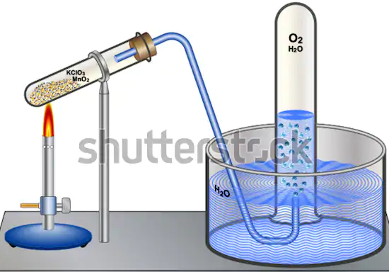

Slide 4
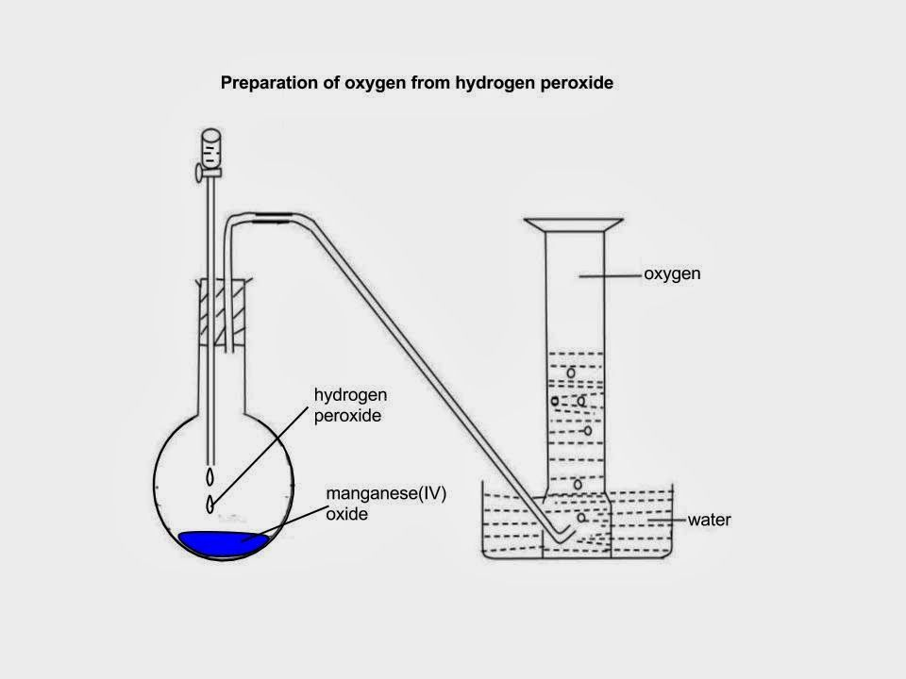

Slide 5
Ag2O -> 2Ag + O2

Slide 6
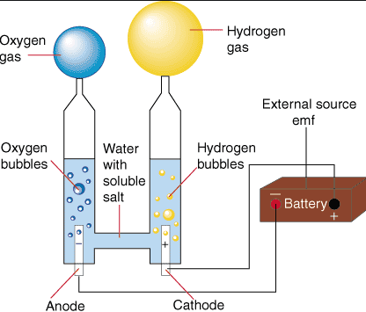
INDUSTRIAL PREPARATION OF OXYGEN

Slide 8
CHEMICAL PROPERTIES OF OXYGEN
Action with Nitrogen
Action with carbon
Action with ammonia
Action with glucose
Action with metals

Slide 9
OZONE O3

Slide 10
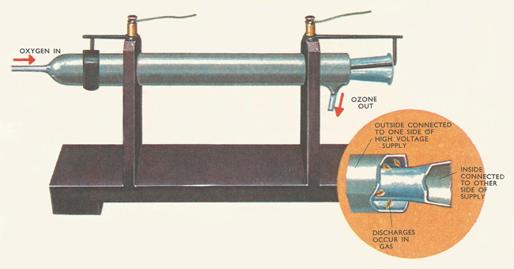
PREPARATION OF OZONE

Slide 12
CHEMICAL PROPERTIES OF OZONE

Slide 13
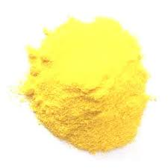
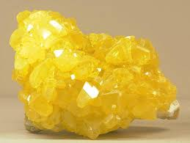
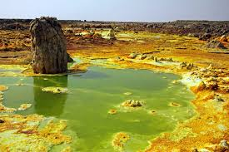
SULPHUR

